Slide 1


NEW WORLD TALENT
Develop your coaching skills
Contact: janice@thescalagroup.co.uk

Slide 2
Develop your coaching skills online
This is a practical, interactive course for managers wishing to develop their coaching style of leadership
It is ideal for:
People who wish to self-manage their skills development
Team coaching
Internal mentoring
A mastery of coaching skills is one of the most valuable tools in the manager’s toolkit
This course includes:
exercises to help you understand and practise the repertoire of skills that will help you get the best out of your people
Guidance on managing a range of people management situations including managing remote and virtual teams and leading others in times of crisis.

Slide 3
What is in New World Talent coaching skills?
Practical activities to help you develop your coaching style of leadership
    effective listening skills
    questioning instead of prescribing solutions
    assisting with setting goals
    giving and receiving feedback
    supporting learning
    identifying and working with strengths
Guidance on dealing with various performance issues
    spontaneous coaching for improvement
    dealing with poor performance
    answering key questions: how am I doing? What is expected of me? What can I do next? How will I be supported to get there? How will I be rewarded?
    people and motivation
    how to deal with low trust and other problems
    managing virtual and remote teams and crisis

Slide 4
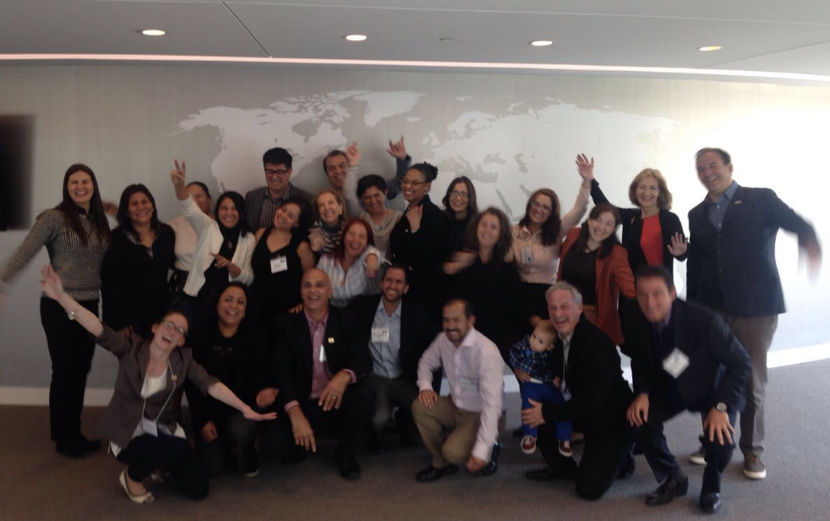

Why is New World Talent different?
It presents topics in many different ways, with options, and not just through video talks to create engaging learning that suits all learning styles
Every topic and every idea is illustrated with real-life examples and scenarios
A variety of activities help you understand the skills, practise them, and become more self-aware
Guided checklists and templates help you manage a range of people management situations including managing at times of crisis
Flexible, just-in-time, in your own time learning
An ePortfolio means you can take notes, and develop your organization's action plan whilst engaging with the resources
It can be tailored to a variety of needs e.g. as a basic course, for self-managed learning, or to work with a ‘buddy’ or coach to mutually support learning
Notes:
Do you have a shared understanding of talent management in your organization?
What do people want from talent management? What must it deliver to help achieve business strategy?
How integrated is talent management in your organization? Do your recruitment, learning, promotion, career and reward practices link?
How effectively can people identify career pathways and how to move along these?
What role does your strategic leadership have in talent management?
How well do you know the people you employ? Their skills? Their potential? Their aspirations?`
Can you track their development?
Performance management
Do you understand..
How different attitudes play out in the organization?
The role of non-financial reward?
The trends and pressures for change?
Especially changing structures?
Performance management infrastructure

Slide 5
Methodology

Slide 6

Practise makes perfect
Coaching is broken into different skills. Each is discussed and presented, often with frameworks to facilitate the process, and usually with examples to bring the skill to life.
Improving your use of just one skill can increase your performance across many areas. It’s all about developing new habits.
This Photo by Unknown Author is licensed under CC BY-NC

Slide 7
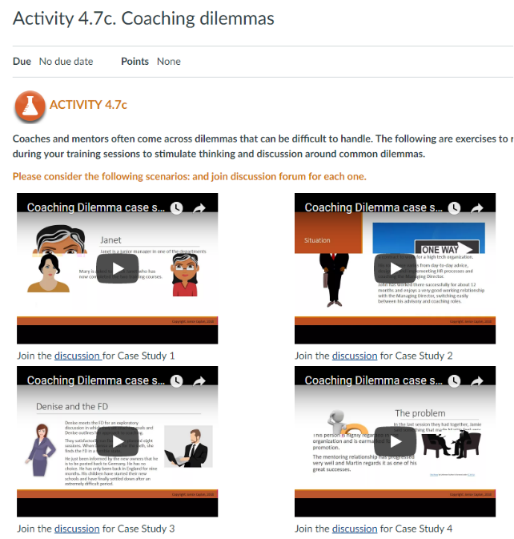
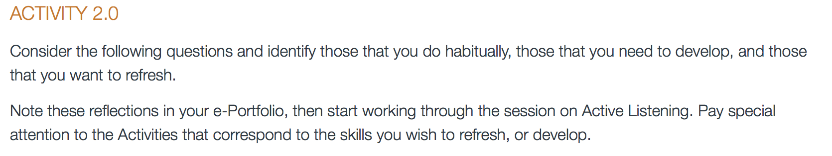
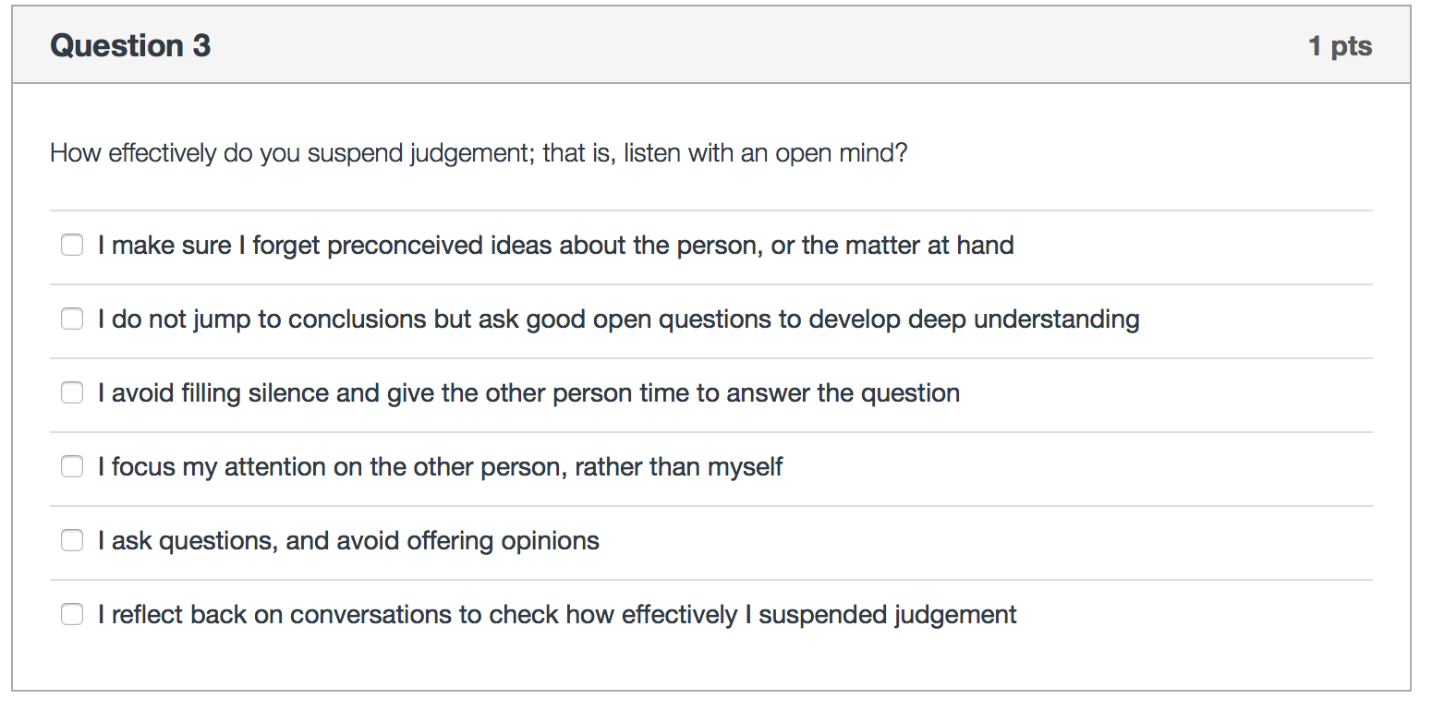
Activities
Activities: reflective exercises and self-awareness checklists help you practise a skill until it becomes habitual

Slide 8



Reflection and Action
At the end of the discussions and activities of each skill, there is a Reflection and Action page and links to the ePortfolio.
REFLECTION
Key learning points from the session are summarized here
Learners are guided to create action plans for implementation at the workplace
ACTION
The ePortfolio can be accessed at any time, and from any place. Here learners record their responses to the Activities, make notes, and also create their personal development plans.
ePORTFOLIO

Slide 9
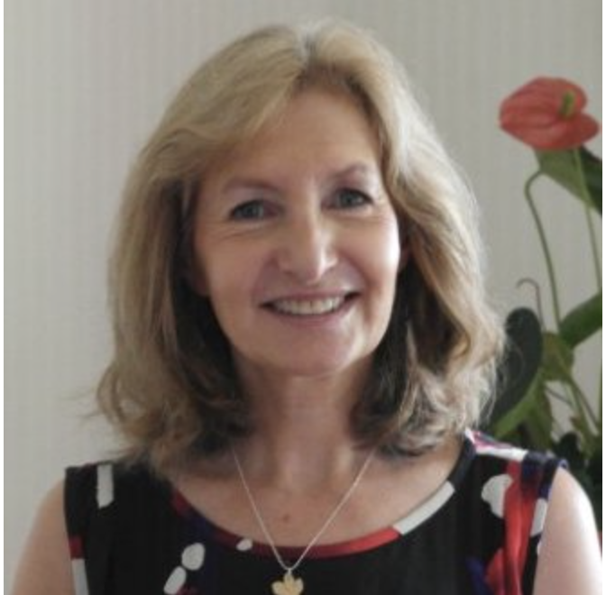
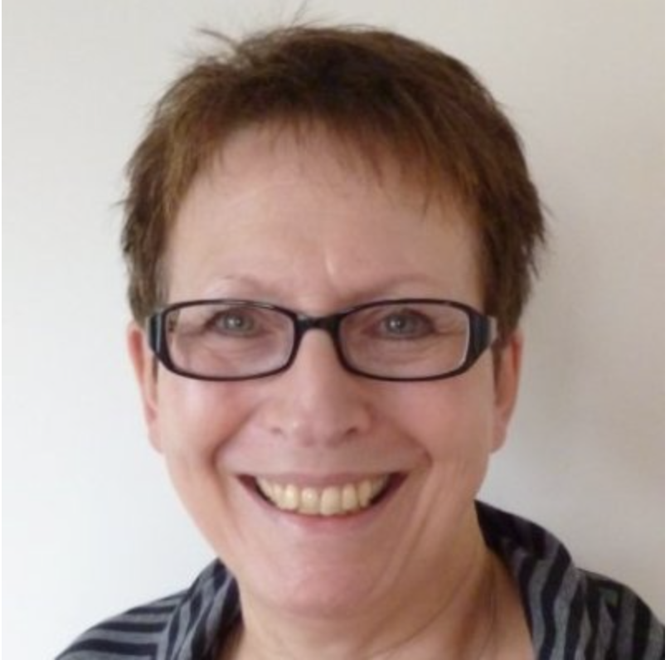
Who are we?
Author
Janice Caplan MA
Hon MBA, CCIPD
An HR Consultant, author, coach-mentor, university governor, HR chair, former CIPD Vice-President. With a Masters’ Degree in HR, and fluent Italian, French and Spanish, Janice works internationally.
Janice’s publications include: Strategic Talent Development (2013), The Value of Talent (2010) both published by Kogan Page, and Coaching for the Future (2003) published by CIPD.
Janice has worked with leading, international organizations on major, often global consultancy projects, and guest lectures at Kingston University London and Moscow, ADEN Business School US and Argentina, and Latam Business School Mexico. Janice’s work has been recognized through various awards including Visiting Professorship Talent Management, Honorary MBA, and the highest HR rank in UK, Chartered Companion of CIPD.
Instructional Designer
Michelle Selinger
MPhil, PhD
A freelance consultant specializing in technology-supported innovation in learning and teaching. She has extensive and acclaimed experience in online and distance learning and has acted as expert consultant and adviser to international agencies including the European Commission, UNESCO, the World Economic Forum Education Initiative, the South African government, and has served as a member of the Australian Federal Minister of Education’s Digital Education Advisory Group.
Michelle has also acted as an education strategy consultant to major IT companies and has recently contributed to the development of a course, Training Teachers to Teach Online.
Previously, Michelle was Director, Education Practice, Cisco Consultancy Services, lecturer in Mathematics Education at University of Cambridge, Lecturer in Education Open University, and Director of Center for New Technologies Research in Education, University of Warwick.

Slide 10

We are keen to collaborate
A wealth of content
‘Develop your coaching skills’ is one of several modules to help you introduce internal mentoring and coaching to your organisations. There are also courses on talent and performance management.
Redesign and brand
We have paid much attention to the look and feel of the courses. However, we are happy for the courses to be rebranded, and redesigned.
Regular updating – Coronavirus and beyond
The courses are all completely up-to-date to include Coronavirus period and beyond, with new ideas and approaches being developed all the time. We are happy to find a basis of collaboration where we keep the courses updated for you.
Add-ons
The courses are designed for asynchronous learning. Possible add-ons include, facilitated group working either online, or in a physical classroom, webinars, personal tutoring, marking and assessment of assignments. We are happy to provide these services, if required.
Platform and Learning Management System
The courses are currently hosted on the Canvas platform and have a full LMS . The content can be migrated to your platform if you require.
This Photo by Unknown Author is licensed under CC BY-SA

Slide 11
Thank You
NEW WORLD TALENT
Develop your coaching skills
Contact: janice@thescalagroup.co.uk
£100 plus VAT per person to include £10 donation to NHS
Overseas delegates £100 to include donation for COVID-19 healthcare

